Slide 1
Health care
Or Livne
Roey

Slide 2
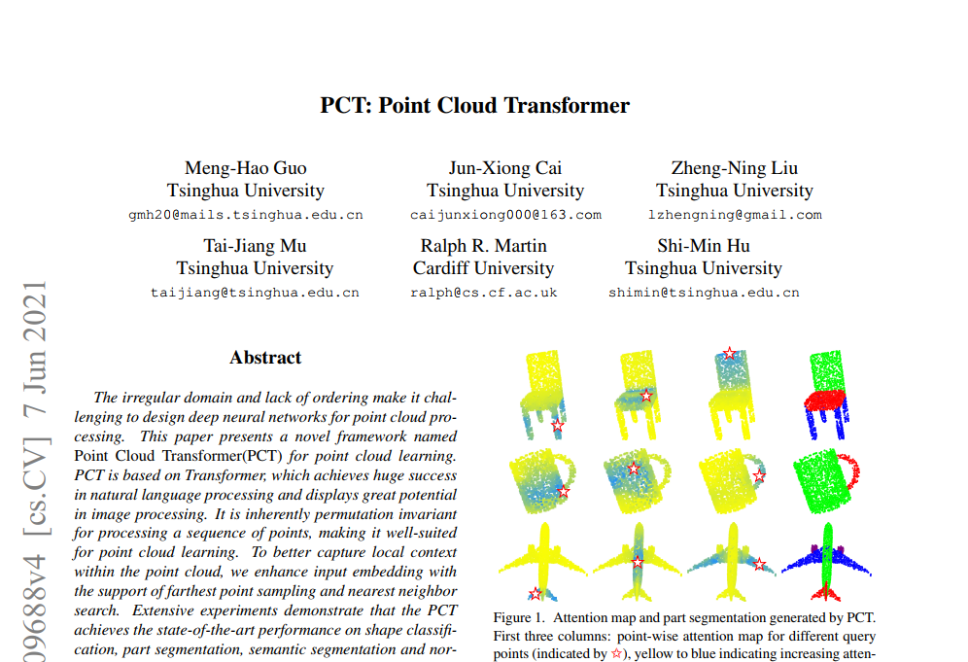
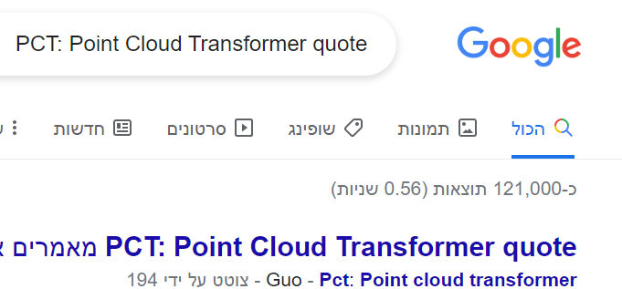
Paper name

Slide 3
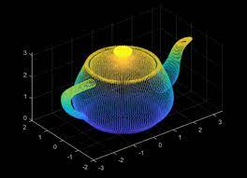
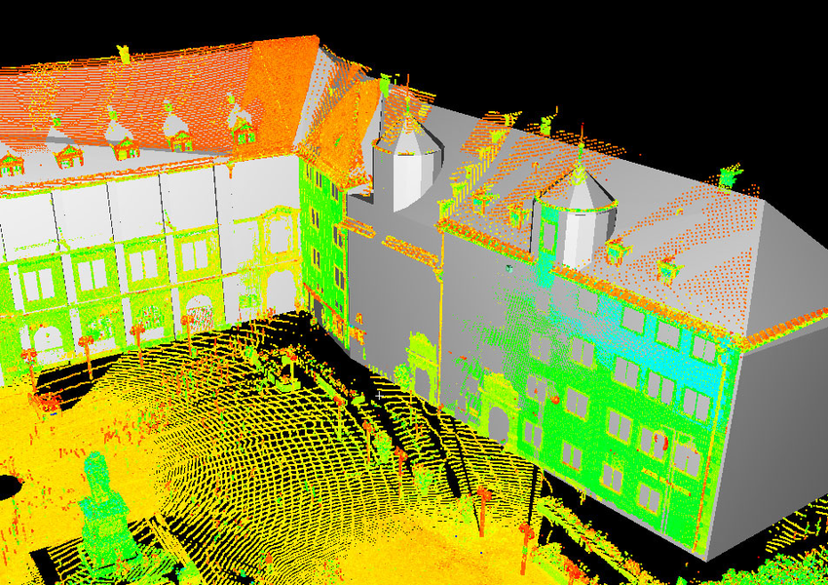
point CLOUD
What is points cloud is ?
How to create point cloud ?
How are they using in different applications ?

Slide 4
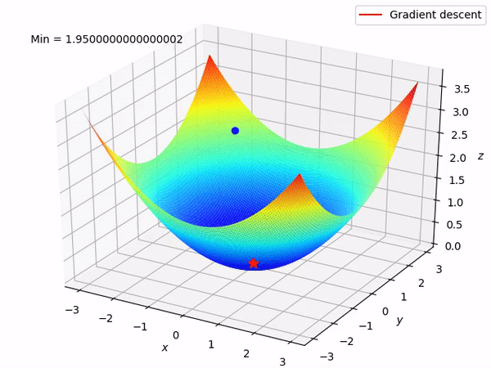
point CLOUD
What is points cloud is ?
Collection of individual 3D point which can be presented by:
Location: (X, Y, Z)
Additional information (Like color (R,G,B) values)
https://www.youtube.com/watch?v=IKfbiFQB_0U

Slide 5
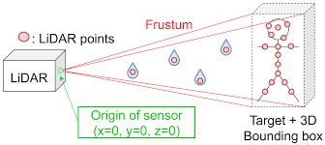
point CLOUD
How to create point cloud ?
Scan by using laser scanner
The laser sending a pulse into static object, by measuring the reflect reaction from the object by laser scanner we can represent each point exact location in 3D

Slide 6
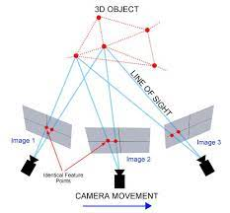
point CLOUD
How to create point cloud ?
Process name Photogrammetry
Creating point cloud by using multiple image of the same object, by triangulate process, the algorithm knows to generate the point cloud

Slide 7
point CLOUD
Mashes:
Convert point cloud to Mesh is a technique for reconstructing a surface mesh from an input point cloud.
In order to move from point cloud in 3D, we move to mesh representation:
https://ranahanocka.github.io/point2mesh/

Slide 8
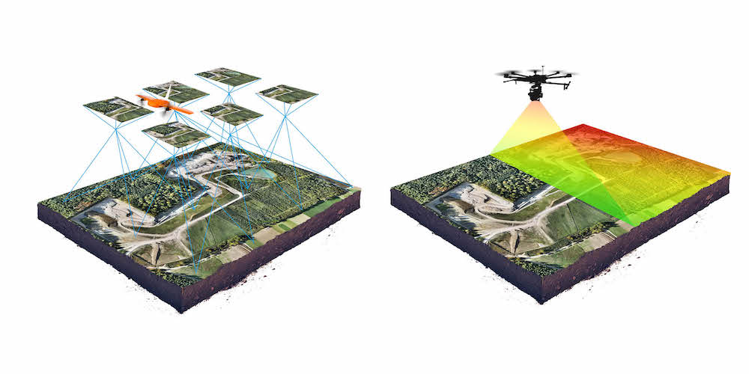
Photogrammetry vs. laser scanner
photogrammetry advantages:
High ability to reproduce an object in full color and texture, While not any 3D scanners can do this
easily accessible to most people because the equipment and software is nowhere near as expensive as 3D scanning.
photogrammetry disadvantages:
challenging to work with parts that have a smooth, flat …
real time as 3D scanning
lower accuracy than 3D scanners.

Slide 9
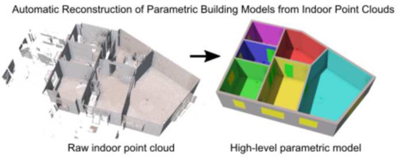
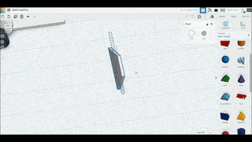
point CLOUD
How are they using in different applications ?
Create a 3D model - point cloud converted into meshes
Understanding environment – building, automotive
Manufacturing – design product

Slide 10
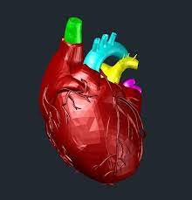
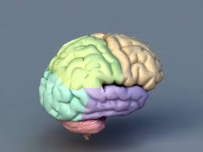
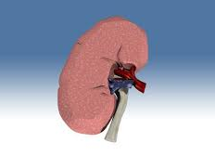
point CLOUD
How are they using in different applications ?
Create a 3D model - point cloud converted into meshes
Medical
Explain ability about different organ in our body
Examine decease
Simulation – for doctor's paretic: https://www.youtube.com/watch?v=2RkmGapgMbc

Slide 11
TIMELINE
Work that inspired the paper writers:
Point net(2017)
Point net ++(2017)
PCT(2021)
Point CNN(2018)
Point GMM(2020)
Point Conv(2020)

Slide 12
TIMELINE
Work that inspired the paper writers:
Point net(2017)
we propose a novel deep neural network PointNet that directly consumes point cloud.
approach for 3D recognition tasks including :
object classification
part segmentation
semantic segmentation
Point net ++(2017)
Improve the ability to capture local structures by query ball grouping.
Point CNN(2018)
generalization of CNN into leveraging spatially-local correlation from data represented in point cloud.
The core of PointCNN is the X -Conv operator that weights and permutes input points and features before they are processed by a typical convolution

Slide 13
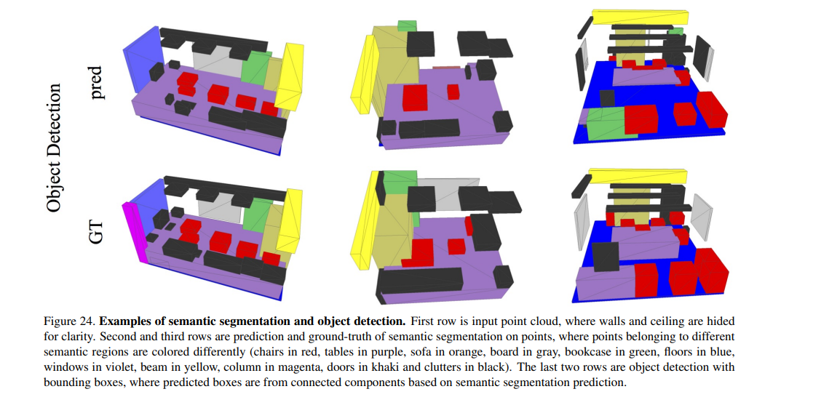
TIMELINE
Work that inspired the paper writers:
Point net(2017)
we propose a novel deep neural network PointNet that directly consumes point cloud.
approach for 3D recognition tasks including :
object classification
part segmentation
semantic segmentation

Slide 14
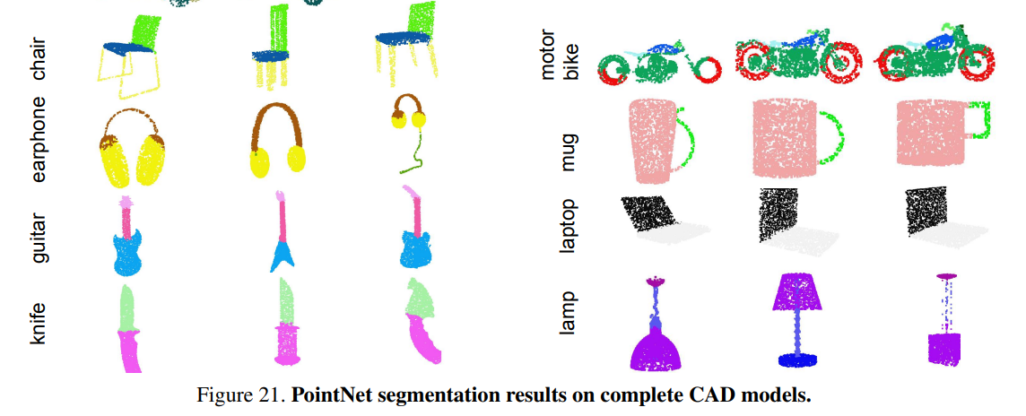
TIMELINE
Work that inspired the paper writers:
Point net(2017)
examples

Slide 15
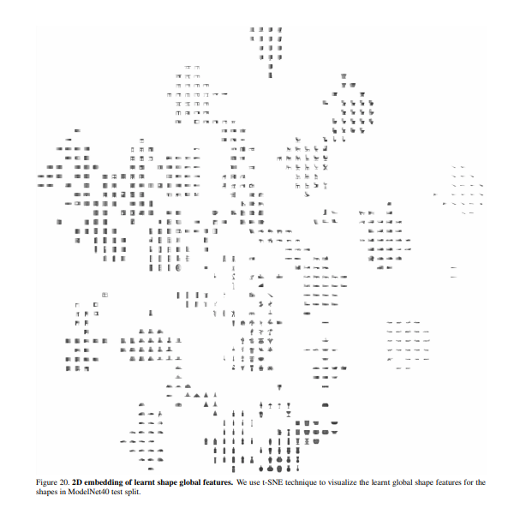
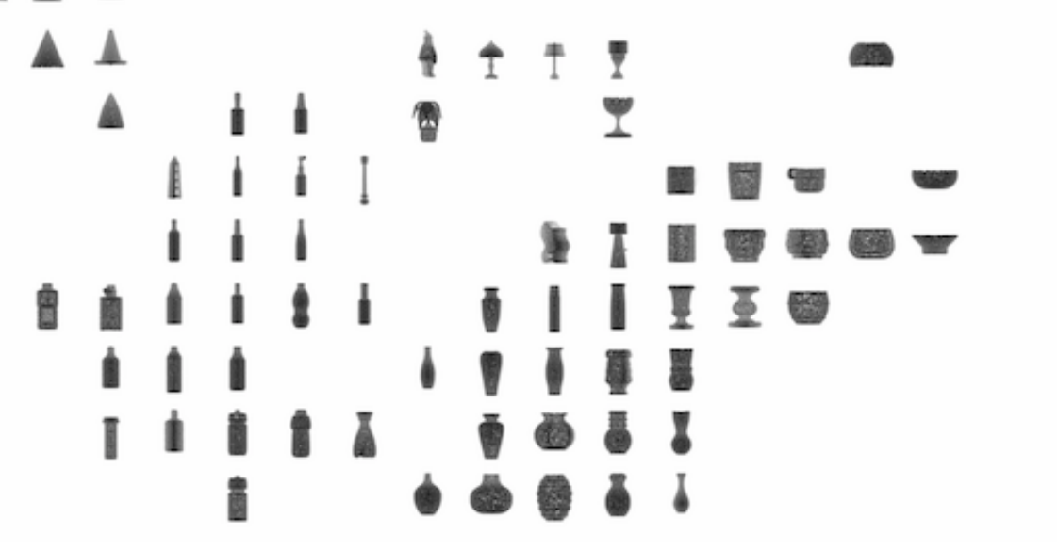
TIMELINE
Work that inspired the paper writers:
Point net(2017)
examples

Slide 16
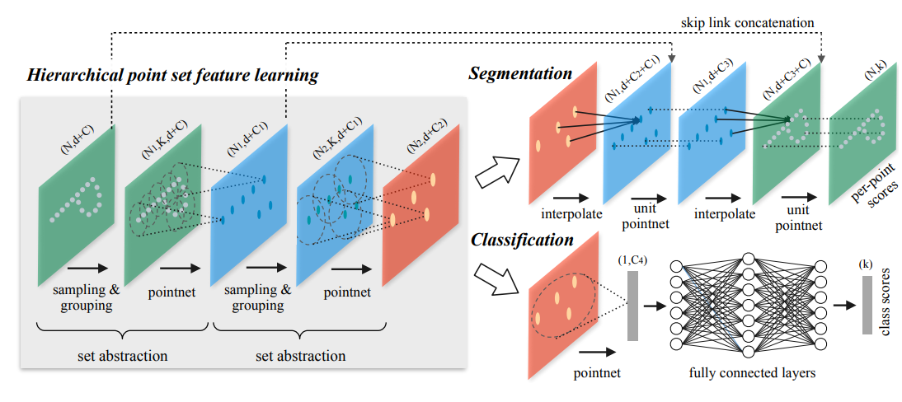
TIMELINE
Work that inspired the paper writers:
Point net ++(2017)
To handle the non uniform point sampling issue, we propose two novel set abstraction layers which aggregate multi-scale information, these contributions enable us to improve accuracy

Slide 17
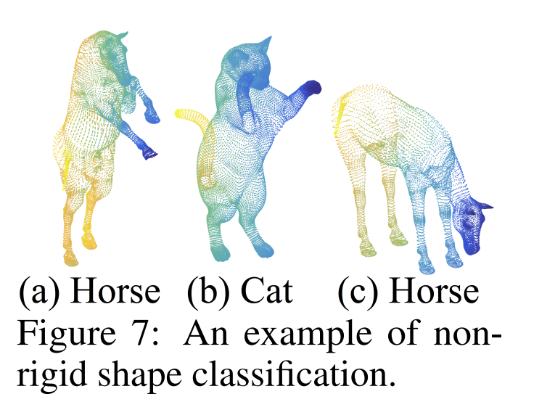
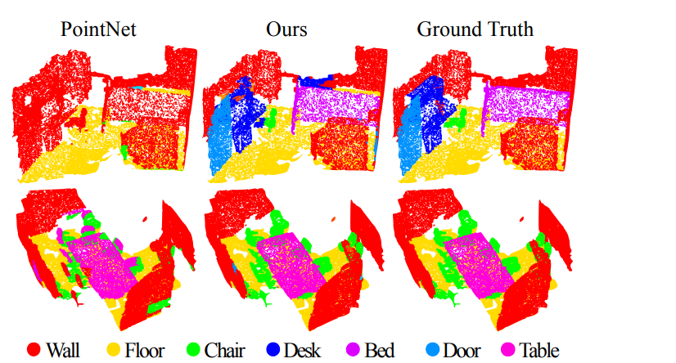
TIMELINE
Point net ++(2017) – visual results

Slide 18
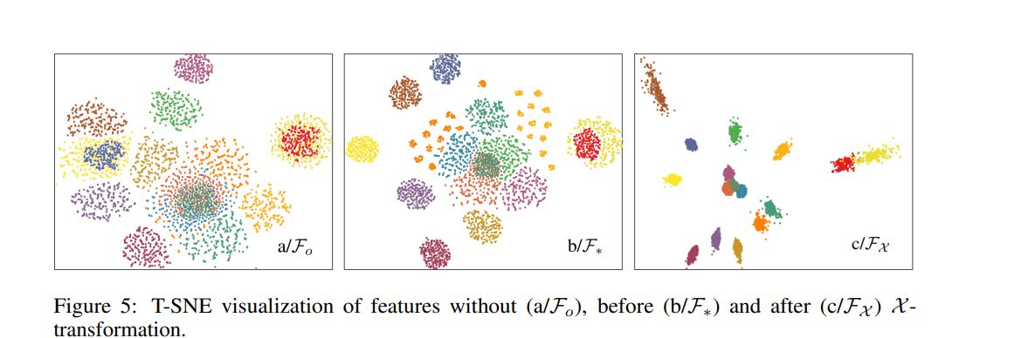
TIMELINE
Work that inspired the paper writers:
Point CNN(2018)
a generalization of CNN into leveraging spatially-local correlation from data represented in point cloud.
The core of PointCNN is the X -Conv operator that weights and permutes input points and features before they are processed by a typical convolution.

Slide 19
TIMELINE
Work that inspired the paper writers:
Point Conv(2020)
perform convolution operation on 3D point clouds, called PointConv.
PointConv trains multi-layer perceptron's on local point coordinates to approximate continuous weight and density functions in convolutional filters, which makes it naturally permutation-invariant and translation-invariant.
This allows deep convolutional networks to be built directly on 3D point clouds.

Slide 20
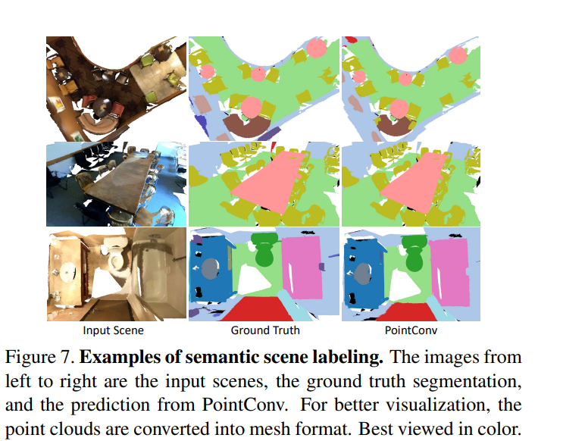
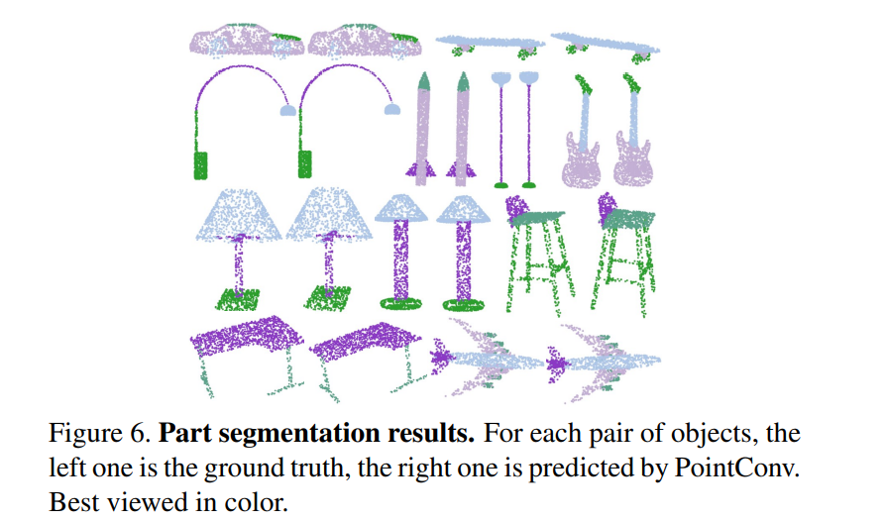
TIMELINE
Point Conv(2020) – visualization

Slide 21
Paper flow
Transformer for Point Cloud Representation
Point-based deep learning
Vision transformers
NLP transformers

Slide 22
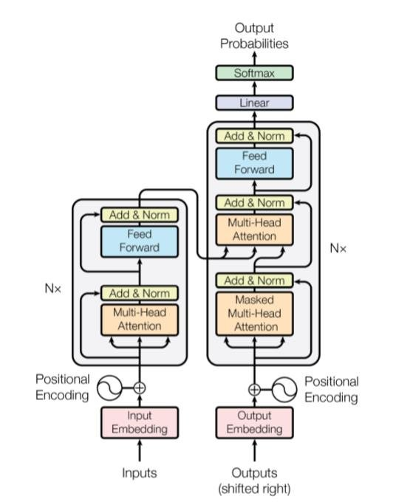
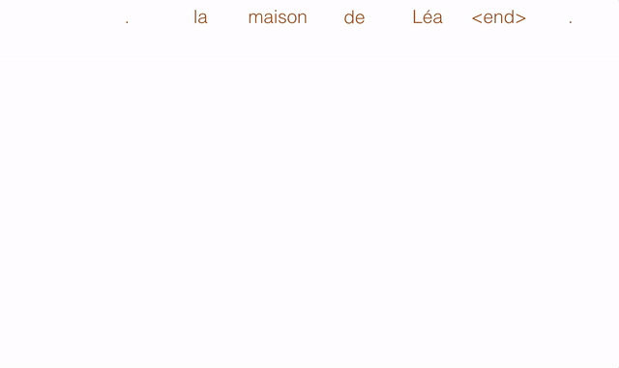
Paper flow
NLP transformers:
New family of natural network architectures from the paper “attention is all you need” (2017 )
the general idea is to add context to the prediction of architectures.
In NLP task needed to convert sentences into sequence of tokens which feed into the attention block.
The NLP transformers achieve state of the art performance on NLP tasks

Slide 23
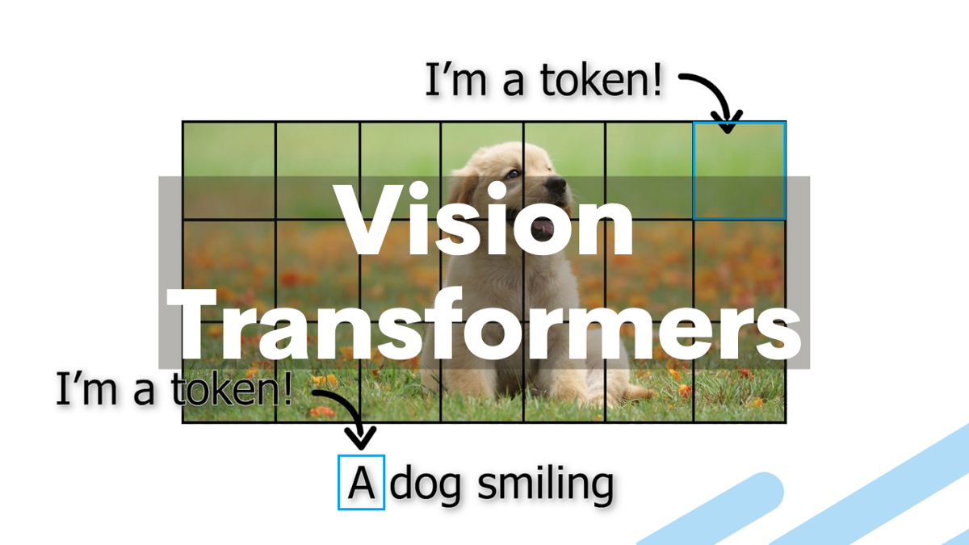
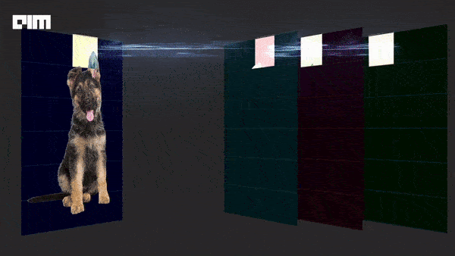
Paper flow
Vision transformers:
Inspired from NLP transformers, vision field, also apply self-attention concept
In order to use transformers, each image need pass tokenization:

Slide 24
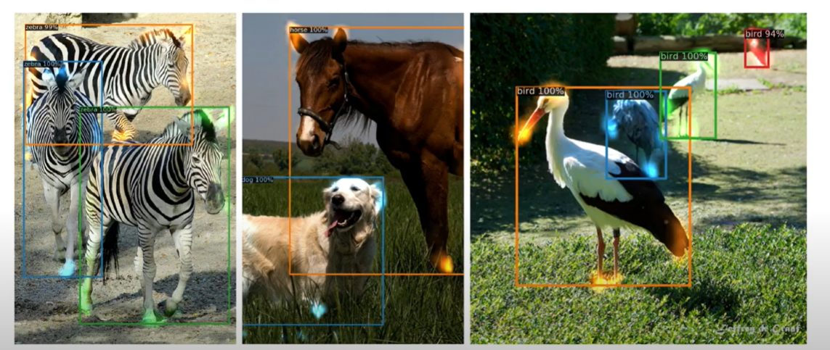
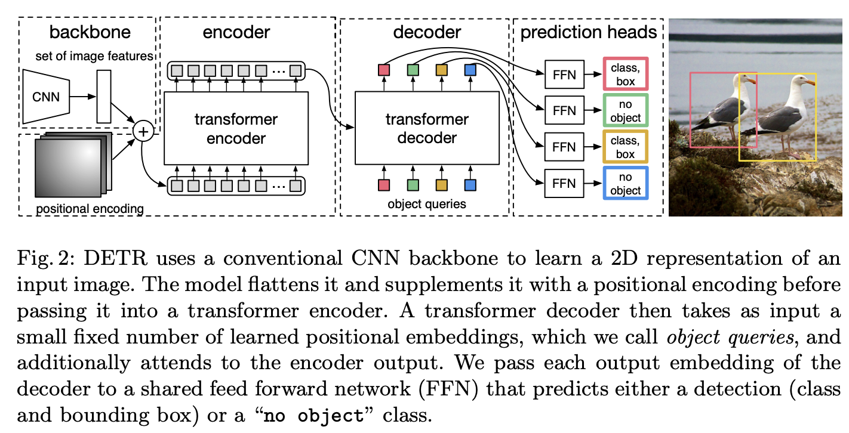
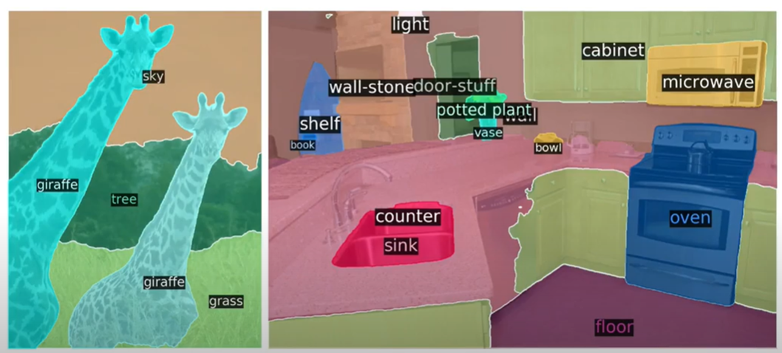
Paper flow
Vision transformers:
the main paper that achieve state of the art results was DETR (2020)

Slide 25
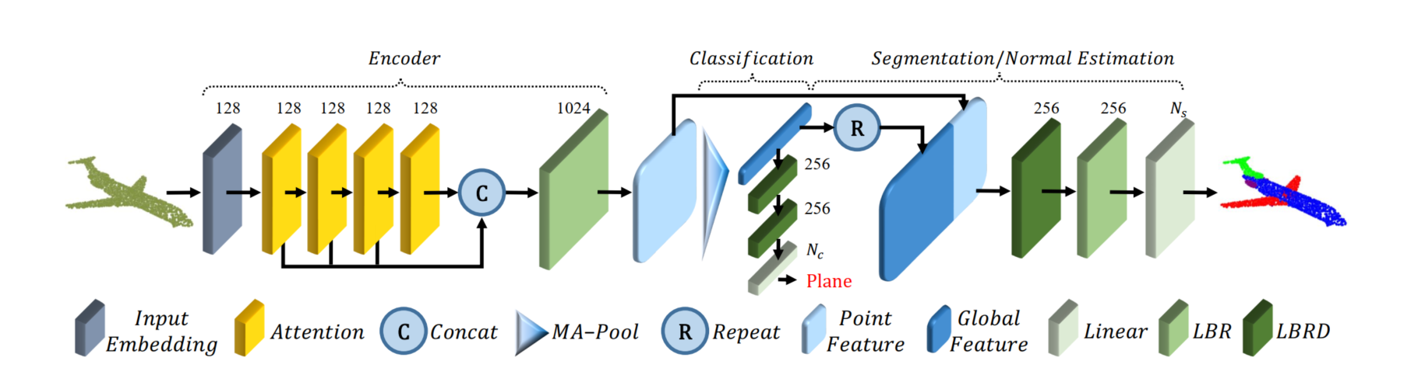
ARCHITHCHER

Slide 26
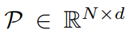
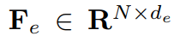
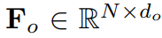
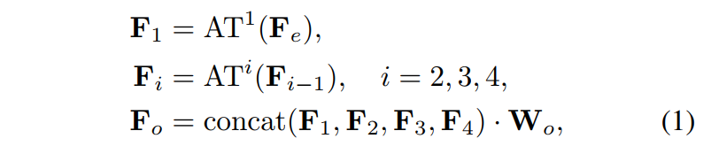
ARCHITHCHER
The encoder aims to transform input points into a new higher dimensional feature space, which can characterize the semantic affinities between points as a basis for various point cloud processing tasks.
The encoder of PCT starts by:
embedding the input coordinates into a higher feature space.
The embedded features are later fed into 4 stacked attention module to learn a semantically rich and discriminative representation for each point followed by a linear layer to generate the output feature.
concatenating the attention output of each attention layer

Slide 27
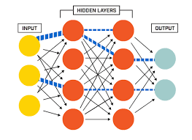
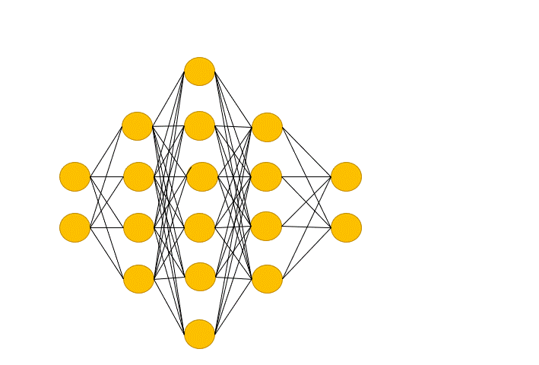
ARCHITHCHER
Linear -
Drop out -

Slide 28
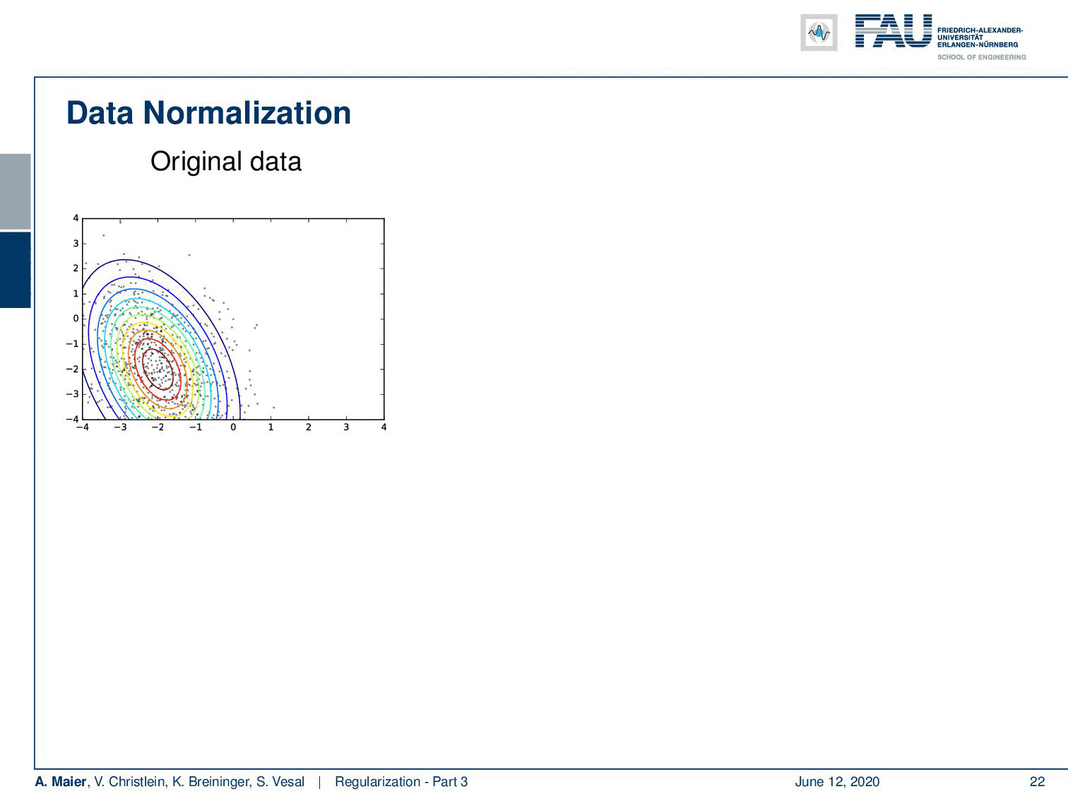
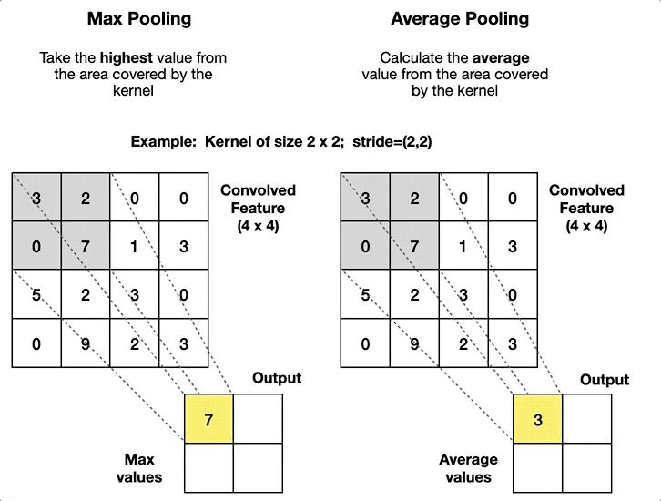
ARCHITHCHER
Batch Normalization -
MA –pooling -

Slide 29
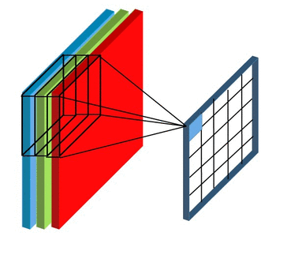
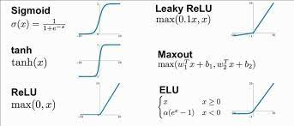
ARCHITHCHER
Point feature - the results of Volumetric convolution on
on voxels for point feature extraction
ReLU -

Slide 30
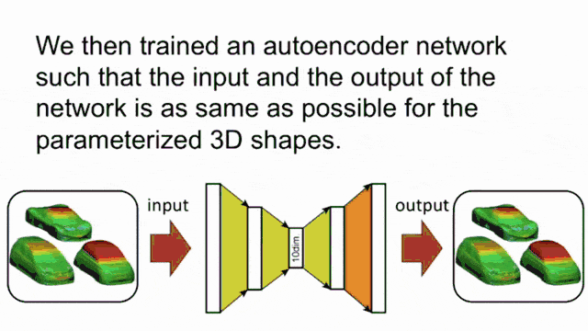
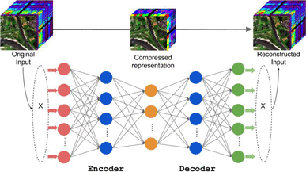
ARCHITHCHER
LBR - combining Linear & Batch Normalization (BN) & ReLU layers
LBRD – LBR & Dropout
Concat - concatenation of layers\attention output
Repeat - return on same later in order to handle dimensions
Global feature - the results of the average pooling
Input Embedding layer -

Slide 31
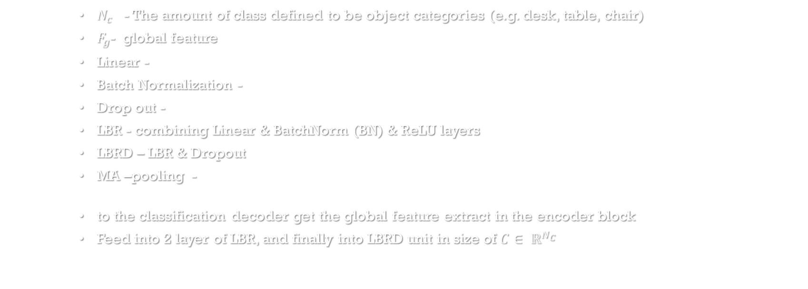
ARCHITHCHER
$N_{c}$ - The amount of class defined to be object categories (e.g. desk, table, chair)
$F_{g}$- global feature
Linear -
Batch Normalization -
Drop out -
LBR - combining Linear & BatchNorm (BN) & ReLU layers
LBRD – LBR & Dropout
MA –pooling -
to the classification decoder get the global feature extract in the encoder block
Feed into 2 layer of LBR, and finally into LBRD unit in size of $C∈ ℝ^{N_{C}}$

Slide 32
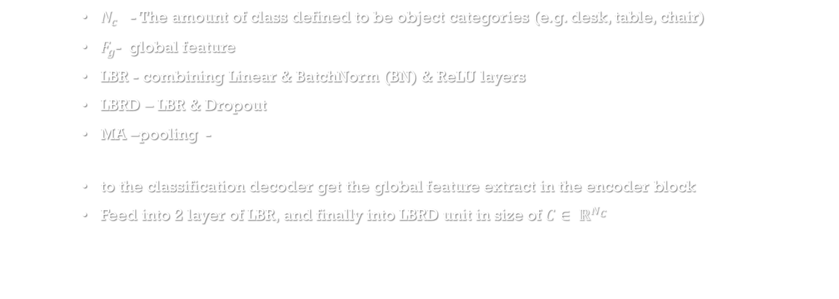
ARCHITHCHER
$N_{c}$ - The amount of class defined to be object categories (e.g. desk, table, chair)
$F_{g}$- global feature
LBR - combining Linear & BatchNorm (BN) & ReLU layers
LBRD – LBR & Dropout
MA –pooling -
to the classification decoder get the global feature extract in the encoder block
Feed into 2 layer of LBR, and finally into LBRD unit in size of $C∈ ℝ^{N_{C}}$

Slide 33
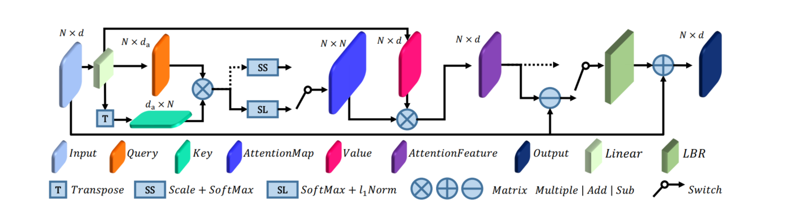
ARCHITHCHER
aaa

Slide 34
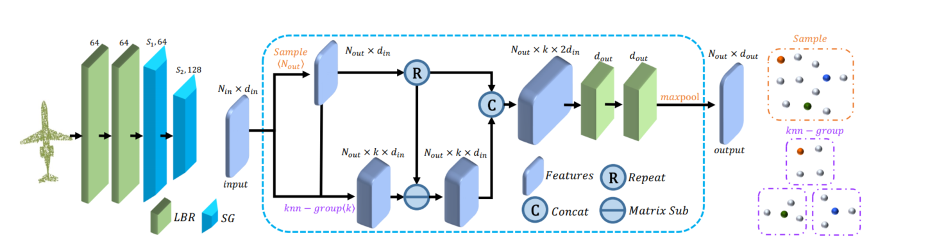
ARCHITHCHER
aaa

Slide 35
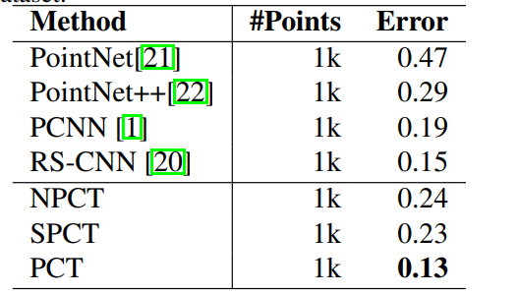
ARCHITHCHER
aaa

Slide 36
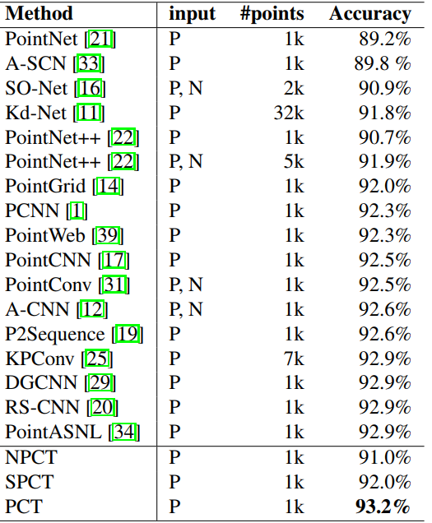
ARCHITHCHER
aaa

Slide 37

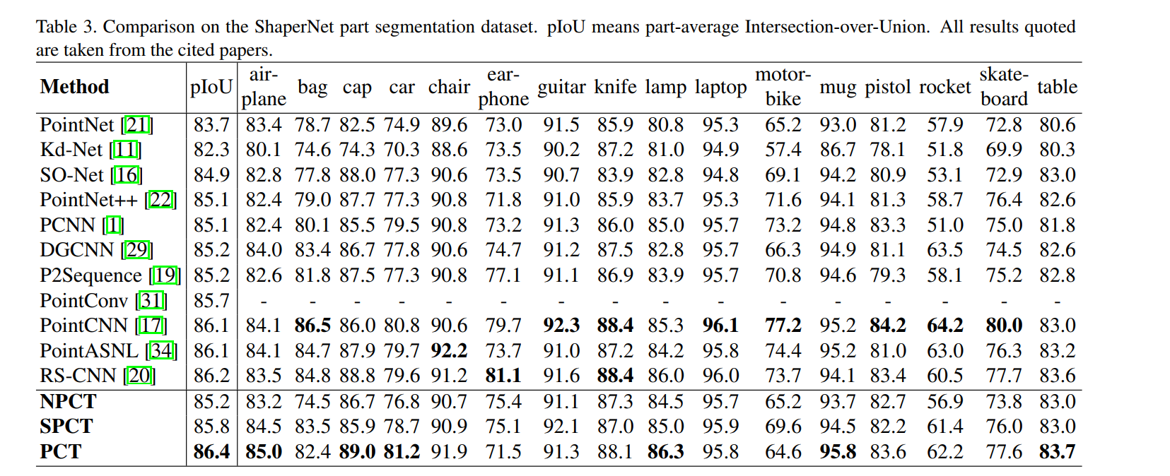
ARCHITHCHER
aaa

Slide 38

ARCHITHCHER
aaa

Slide 39
Point cloud in health care
aaa

Slide 40
CONCULISION
In this paper, we propose a permutation-invariant point cloud transformer, which is suitable for learning on unstructured point clouds with irregular domain. The proposed offset-attention and normalization mechanisms help to make our PCT effective. Experiments show that PCT has good semantic feature learning capability, and achieves state-of-the-art performance on several tasks, particularly shape classification, part segmentation and normal estimation. Transformer has already revealed powerful capabilities given large amounts of training data. At present, the available point cloud datasets are very limited compared to image. In future, we will train it on larger datasets and study its advantages and disadvantages with respect to other popular frameworks. Besides, the encoder-decoder structure of Transformer support more complex tasks, such as point cloud generation and completion. We will extend the PCT to further applications

